Slide 1
Analytical Methods in Mechanochemistry Research
Why Comprehensive Analysis is Essential
Mechanochemical processes involve simultaneous changes at multiple length scales—atomic (defect generation, bond breaking), nanoscale (particle size, surface area), and macroscopic (phase composition, morphology). No single technique captures the complete picture.
Multi-technique approach provides:
Phase identification (what products form)
Structural characterization (crystallinity, defect density, strain)
Morphological insights (particle size, surface roughness)
Thermodynamic/kinetic data (activation energy, reaction rates)
Surface chemistry (oxidation states, functional groups, contamination)
Typical workflow:
Real-time or periodic monitoring during milling (XRD, DSC)
Post-reaction characterization (SEM, TEM, BET)
Quantitative analysis (ICP, elemental analysis)
Mechanistic interpretation (spectroscopy, computational support)

Slide 2
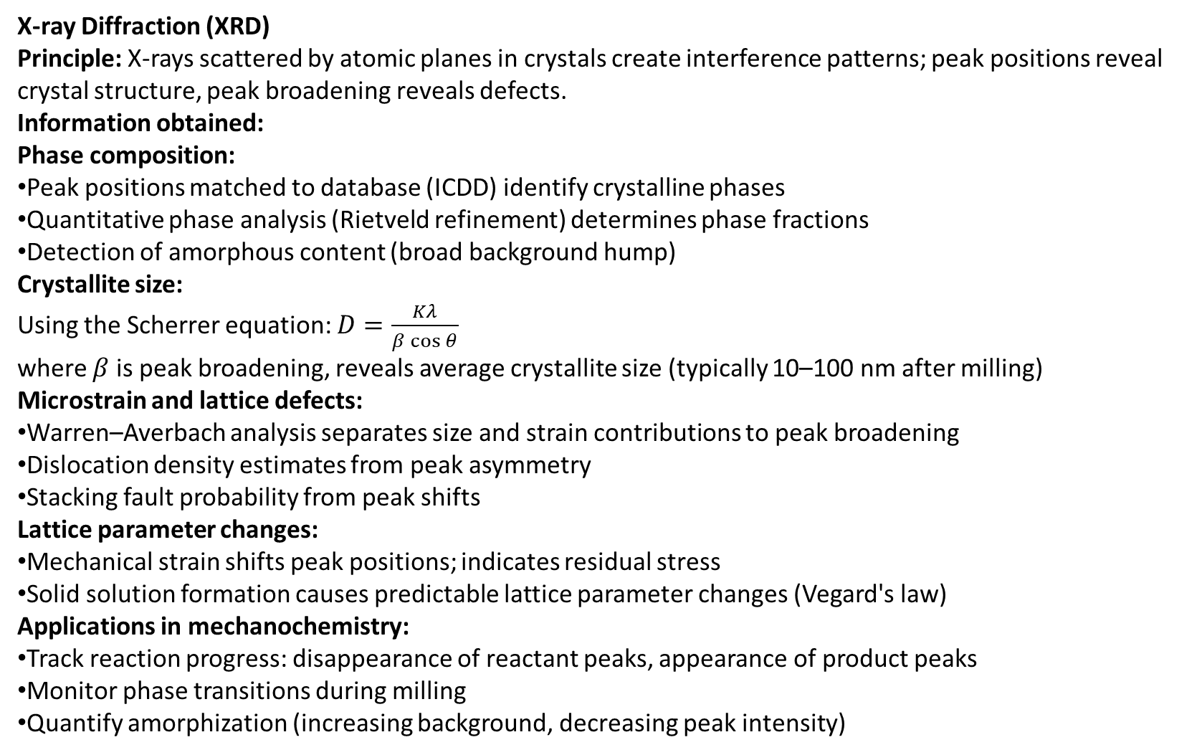
Analytical Methods in Mechanochemistry Research
X-ray Diffraction (XRD)
Principle: X-rays scattered by atomic planes in crystals create interference patterns; peak positions reveal crystal structure, peak broadening reveals defects.
Information obtained:
Phase composition:
Peak positions matched to database (ICDD) identify crystalline phases
Quantitative phase analysis (Rietveld refinement) determines phase fractions
Detection of amorphous content (broad background hump)
Crystallite size: Using the Scherrer equation: $D=\frac{Kλ}{β\cos{θ}}$ where $β$ is peak broadening, reveals average crystallite size (typically 10–100 nm after milling)
Microstrain and lattice defects:
Warren–Averbach analysis separates size and strain contributions to peak broadening
Dislocation density estimates from peak asymmetry
Stacking fault probability from peak shifts
Lattice parameter changes:
Mechanical strain shifts peak positions; indicates residual stress
Solid solution formation causes predictable lattice parameter changes (Vegard's law)
Applications in mechanochemistry:
Track reaction progress: disappearance of reactant peaks, appearance of product peaks
Monitor phase transitions during milling
Quantify amorphization (increasing background, decreasing peak intensity)

Slide 3
Analytical Methods in Mechanochemistry Research
Infrared Spectroscopy (FTIR)
Principle: Infrared radiation excites molecular vibrations; absorption frequencies characteristic of functional groups and chemical bonds.
Information obtained:
Functional group identification:
O-H stretch (broad, 3200–3600 cm⁻¹): hydroxides, water, alcohols
C=O stretch (~1700 cm⁻¹): carbonates, carboxylic acids, esters
C-H stretch (2800–3000 cm⁻¹): organic matter, contamination
M-O stretch (400–1000 cm⁻¹): metal oxides, metal hydroxides, metal carbonates
M-N, M-S stretches reveal nitrides, sulfides, sulfates
Chemical reaction monitoring:
FTIR spectra taken at intervals during milling reveal functional group changes
Disappearance of O-H stretch indicates dehydration of hydroxides
Evolution of carbonate or oxide peaks tracks product formation
Structural information:
Peak shape and width relate to local coordination and disorder
Amorphous vs. crystalline phases show different spectral features
Particle size affects peak positions (surface vs. bulk effects)
Surface chemistry:
Adsorbed species (gases, moisture, lubricants) detected on nanoparticle surfaces
Oxidation state changes (e.g., Fe²⁺ vs. Fe³⁺) cause peak shifts
Quantitative analysis:
Peak area correlates with concentration (Beer-Lambert law)
Enables kinetic tracking during milling: conversion percentage vs. time

Slide 4
Analytical Methods in Mechanochemistry Research
Thermal Analysis (DSC, TGA)
Differential Scanning Calorimetry (DSC):
Measures heat flow associated with phase transitions, reactions, or decomposition
Exothermic peaks indicate energy release (e.g., crystallization, oxidation)
Endothermic peaks indicate energy absorption (e.g., melting, dehydration)
Mechanochemistry applications:
Stored energy release:
Mechanically activated samples show exothermic peak upon heating
Peak area proportional to stored energy (5–50 kJ/mol typical)
Temperature of peak maximum relates to activation energy
Phase stability:
Identification of phase transitions (e.g., amorphous → crystalline)
Thermal stability limits for mechanochemically synthesized phases
Thermogravimetric Analysis (TGA):
Continuous mass monitoring during heating
Detects decomposition, dehydration, oxidation
Mechanochemistry applications:
Hydration state:
Mass loss corresponding to water release identifies hydroxide vs. oxide phases
Degree of hydration after milling
Decomposition kinetics:
Onset temperature shifts to lower T for activated materials (mechanochemical activation effect)
Reaction rate increases due to defects and surface area
Purity and composition:
Expected mass losses calculated from stoichiometry
Deviations indicate impurities or incomplete reaction

Slide 5
Analytical Methods in Mechanochemistry Research
Microscopy and Surface Analysis
Scanning Electron Microscopy (SEM):
Direct visualization of particle morphology, size, aggregation
Typical resolution: 10–100 nm
Energy-dispersive X-ray (EDX) spectroscopy: elemental composition mapping
Reveals surface texture, fracture patterns, coating thickness
Transmission Electron Microscopy (TEM):
Atomic-scale resolution (0.1–1 nm)
Lattice imaging reveals crystal structure, defects, grain boundaries
Chemical analysis via electron energy loss spectroscopy (EELS)
Direct evidence of nanocrystallinity and interfaces in composites
Brunauer–Emmett–Teller (BET) method:
Nitrogen adsorption isotherm measures specific surface area
Pore size distribution from desorption branch
Tracks changes in surface area during milling (typically 10–100 m²/g after milling)
X-ray Photoelectron Spectroscopy (XPS):
Elemental composition and oxidation state of surface (top 10 nm)
Peak position shifts reveal chemical environment
Quantification of surface oxidation or contamination
Raman Spectroscopy:
Vibrational spectroscopy complementary to IR
Detects disorder in graphitic materials, defects in crystals
Non-destructive; good for nanostructured materials

Slide 6
Analytical Methods in Mechanochemistry Research
Integration and Data Interpretation
Typical multi-technique investigation:
For a mechanochemical synthesis of a complex oxide (e.g., LaFeO₃ from La₂O₃ + Fe₂O₃):
XRD: Track phase evolution—reactant peaks disappear, product peaks grow. Determine when single-phase product forms.
FTIR: Confirm La-O and Fe-O bonding; verify no residual hydroxide or carbonate.
SEM: Visualize particle morphology—from micron-scale starting material to 50–100 nm product particles.
BET: Measure specific surface area increase from ~5 m²/g (starting oxide) to ~30–50 m²/g (milled product).
TGA/DSC: Confirm purity—no residual moisture or decomposable phases. Measure stored mechanical energy (exothermic peak).
ICP-OES (Inductively Coupled Plasma Optical Emission Spectrometry): Quantify La:Fe ratio; detect impurities from milling media.
Interpretation:
Combined data confirms stoichiometric single-phase product
Nano-scale particle size and high surface area suitable for catalytic application
Stored energy and defects enhance chemical reactivity
Literature comparison:
Compare results to published benchmarks for mechanochemical synthesis of same material
Validate efficiency and reproducibility

